Slide 1
Anticipating threats in natural Systems
UNCLASSIFIED
Integrated Risk-Based Environmental Modeling of Extreme Coastal Weather Events
Dr. Todd Steissberg (ERDC-EL)
Dr. Chuck Downer (ERDC-CHL)
Dr. Matt Smith (USACE-IWR)
Ms. Marriah Abellera (USACE-IWR)
Mr. John Kucharski (ERDC-EL → Deltares)
Dr. Jennifer Olszewski (ERDC-EL → USGS)
Ms. Lauren Melendez (ERDC-EL → ERDC-GRL)
MAJ Travis Nicolette (ERDC-CHL)
Mr. Isaac Mudge (USACE New Orleans District)
Ms. Kelsey Walak (USACE Sacramento District)
ACTIONS IPR Meeting, September 24, 2024

Slide 2
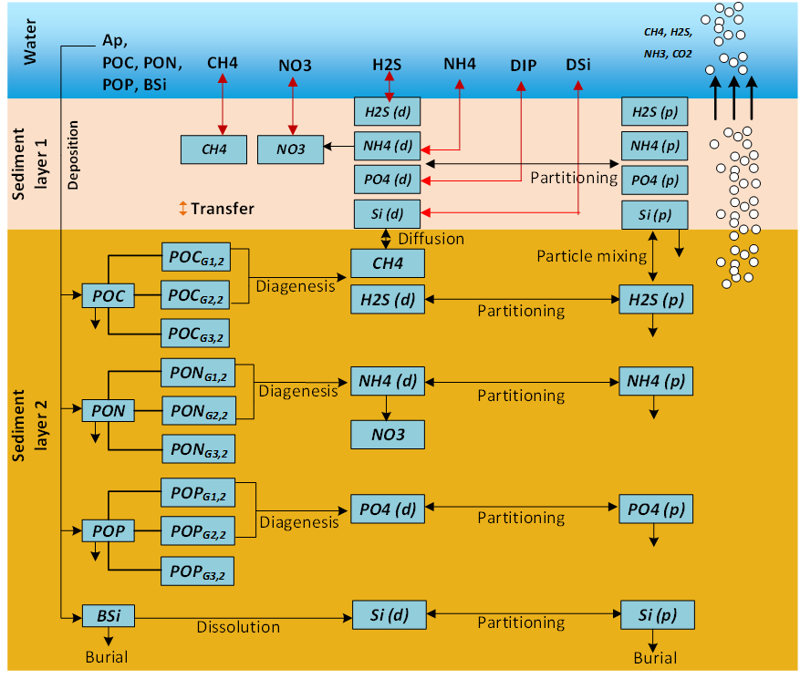
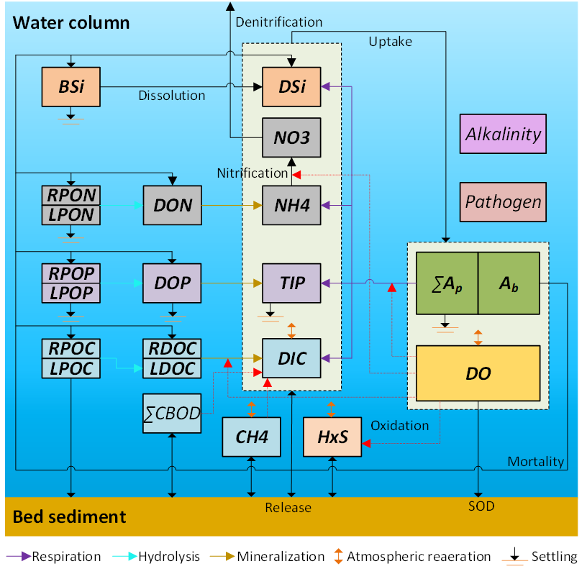
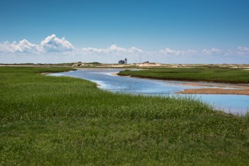
Objective: Integrated Hydro-Ecological Modeling
Develop integrated hydro-ecological models that simulate the complex and dynamics interactions between hydrology, meteorology, climate, water quality (salinity, temperature, nutrients), soil chemistry, vegetation, and morphology processes.
Models will enable evaluating system vulnerabilities and identifying adaptation pathways to improve the resilience of coastal ecosystems to environmental stresses, such as increasing frequency and intensity of coastal storm surges and extreme precipitation events, rising sea levels, decreasing freshwater flows, and increased salinity intrusion.

Slide 3
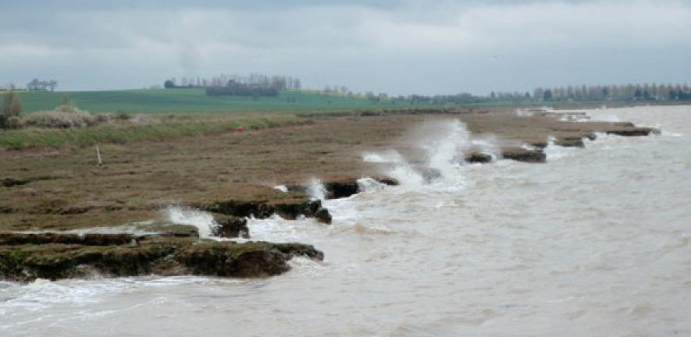
Objective: Integrated Hydro-Ecological Modeling
Models will incorporate process descriptions from the other ACTIONS teams to provide the ability to simulate future conditions and provide more rigorous design tools for construction of Nature Based Features (NBF).
Provides tools for Engineering with Nature (EWN) projects that accurately simulate future conditions with and without projects at the temporal and spatial scales necessary for engineering design

Slide 4
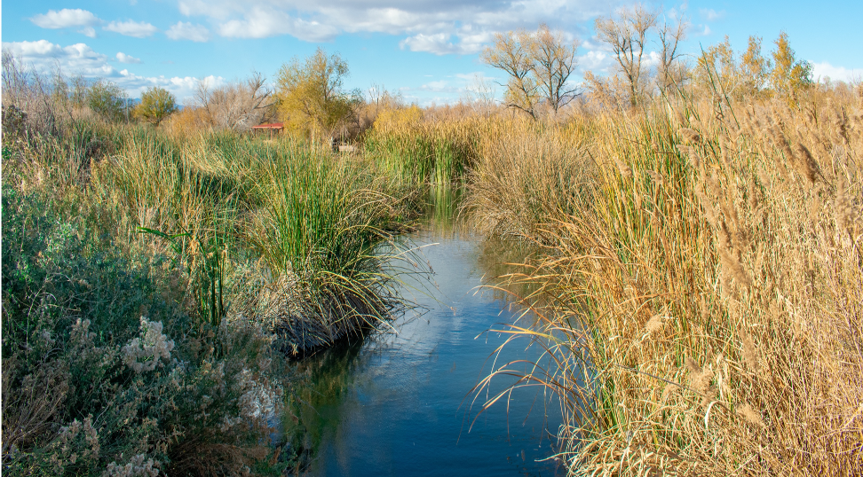
Environmental Modeling Tasks
Environmental Forcing Models
Simulate combinations of environmental forcing conditions to generate a plausible range of coastal hazards while preserving the complex interaction between contributing processes
Water Quality Models
Ecological Models
Relate indicator species responses - e.g., growth and health to water balance components, soil conditions, surface and subsurface water quality - to environmental forcing
Simulate watershed and riverine water quality and contaminant release from soils under saline conditions

Slide 5
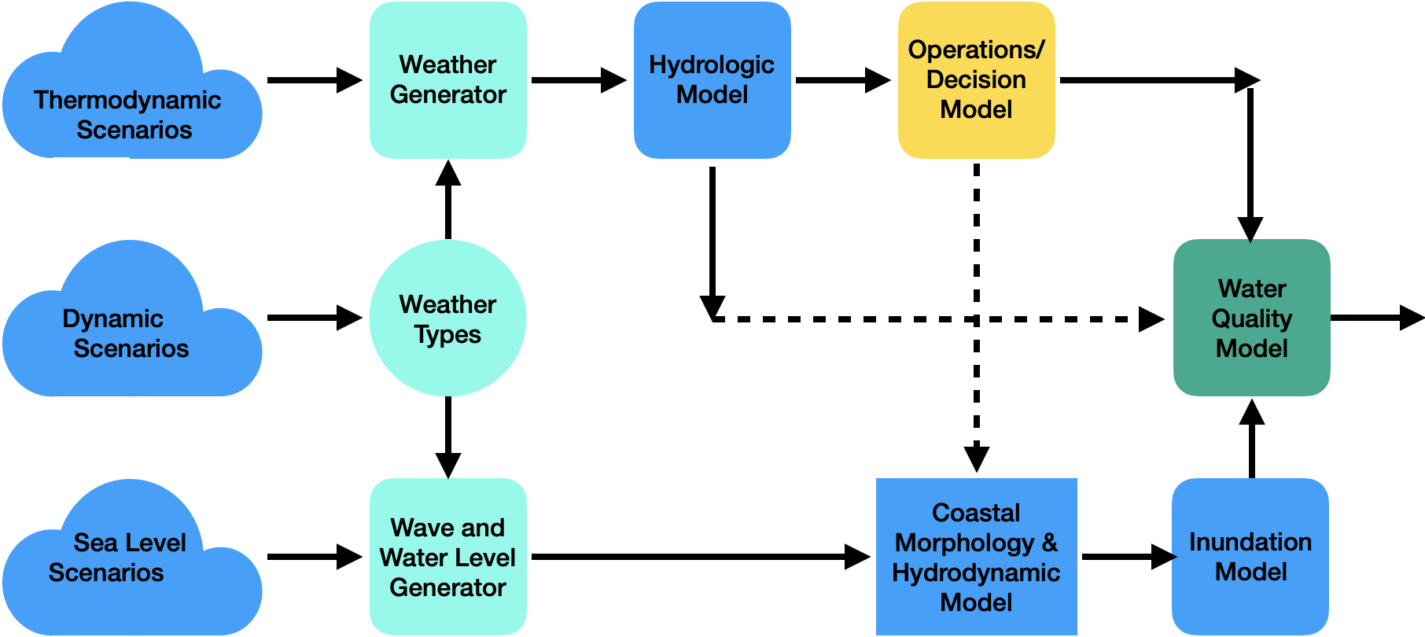
System Modeling Framework
Hydro-Ecological Salt Marsh Model

Slide 6
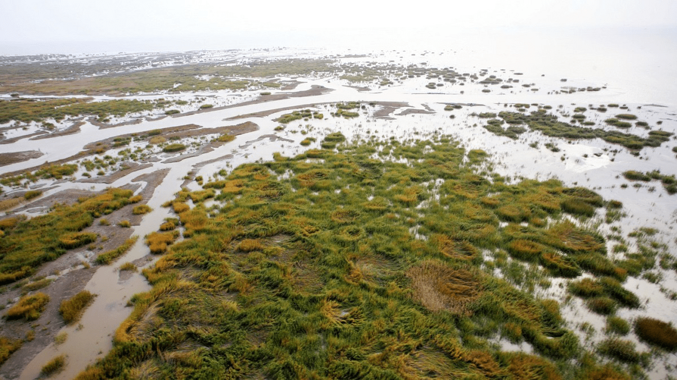
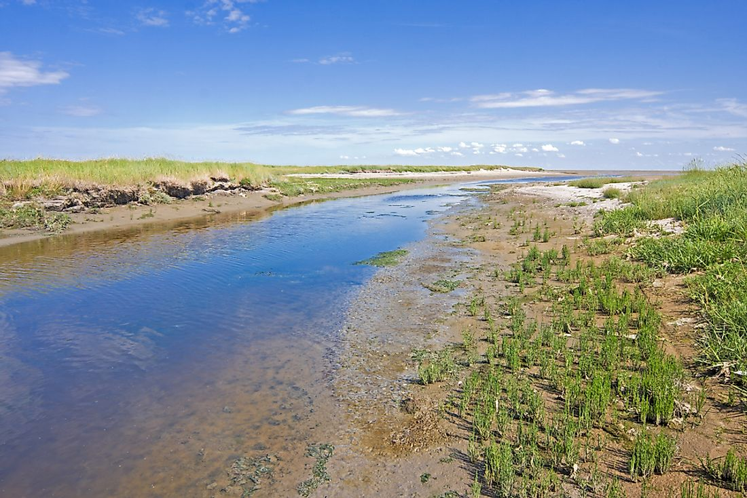
FY24 Accomplishments
Water Quality Model
Completed development of the ClearWater-Riverine Model
Leverages HEC-RAS 2D models
Model grid
Hydrodynamics of simple and complex river systems
River channel
Flood plains
Braided rivers
Riparian buffers
Simulates water temperature and quality (nutrients, algae, dissolved oxygen) and their flow through ecosystems

Slide 7
FY24 Accomplishments
Water Quality Model
Linking ClearWater with the GSSHA (ERDC-CHL) and PHREEQC (USGS) models for contaminant modeling:
WEBMOD (USGS’s Water, Energy, and Biogeochemical Model) flows linked with HEC-RAS-2D
Linking WEBMOD single-cell water quality outputs linked with ClearWater
Specifically linking with PHREEQC within WEBMOD:
PHREEQC is an aqueous geochemical model that simulates chemical reactions as waters evaporate, mix, and react within the various reservoirs of the model. The reactions that can be specified for a reservoir include equilibrium reactions among water, minerals, surfaces, exchangers, and kinetic reactions such as kinetic mineral dissolution or precipitation, biologically mediated reactions, and radioactive decay.
WEBMOD also simulates variations in the concentrations of the stable isotopes deuterium and oxygen-18 as a result of varying inputs, mixing, and evaporation.
Data storage and exchange library to link the hydrologic and hydraulic models with the water quality and vegetation models.

Slide 8
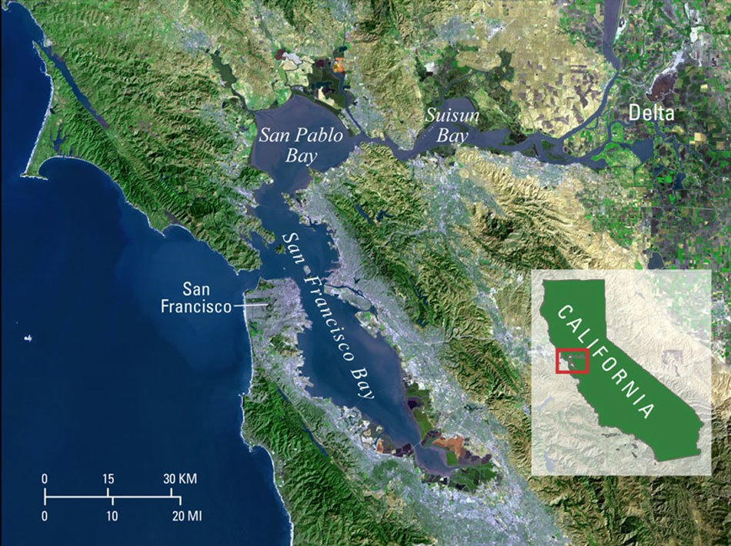
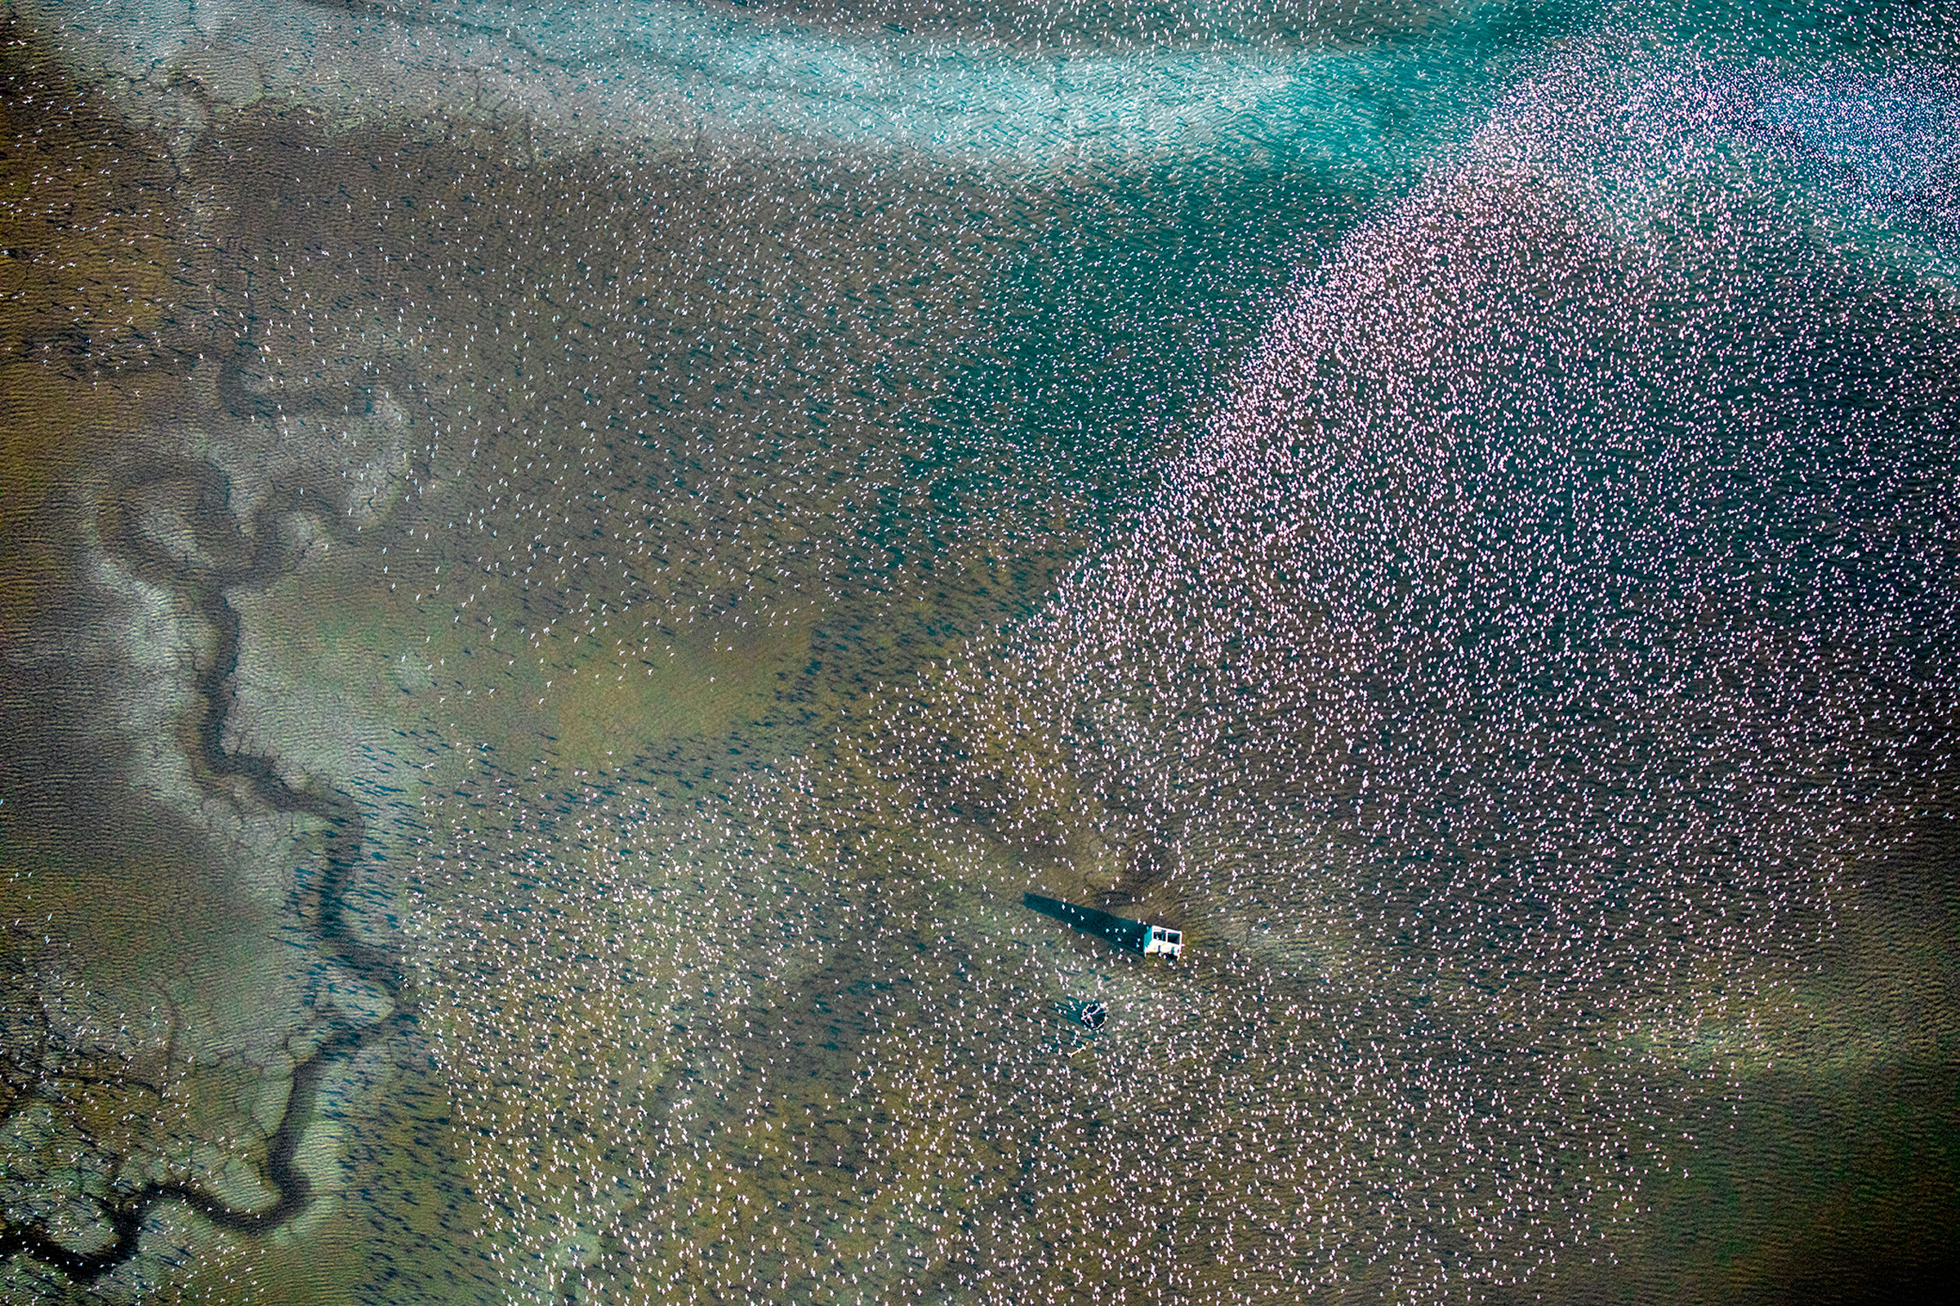
FY24 Milestones and Products
Salt Marsh Model
Q2/FY24 (Deliverable): Completed running salt marsh model for Dotson Family Marsh (baseline conditions) case study that couples Delft 3D hydrodynamics + waves, NBSDynamics vegetation, and the NETHERLAND morphology models.
Q3/FY24 (Milestone): Define time series, inputs, and Sobel variance analysis scenarios to run
Journal paper: in progress (delayed)

Slide 9
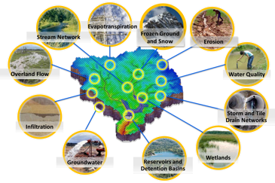
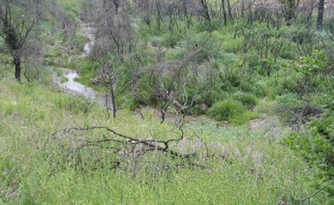
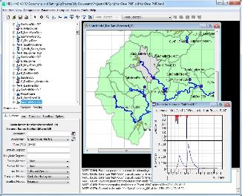
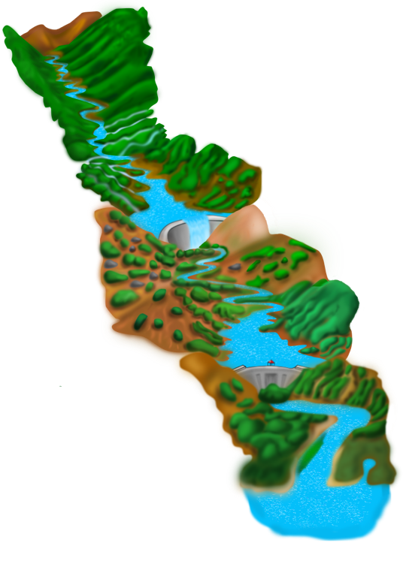
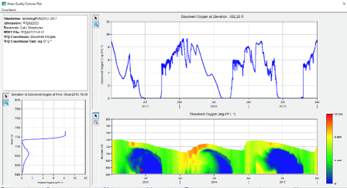
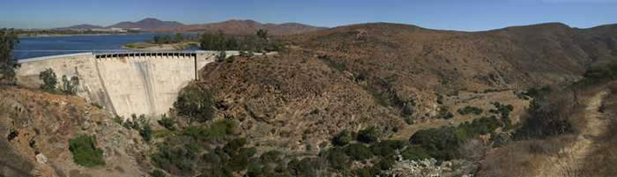
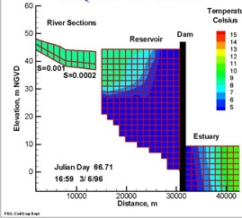
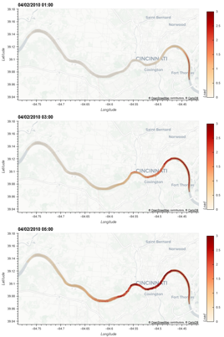
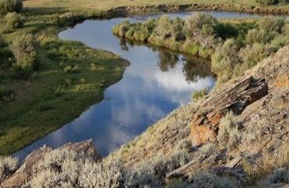
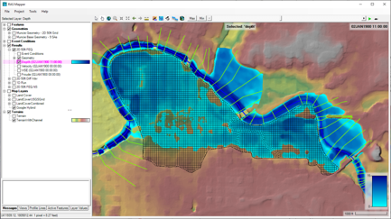
Water Quality and Environmental Systems Modeling
Temperature
Nutrients
Dissolved Oxygen
Algae
Metals
Contaminants
ERDC’s Corps Library for Environmental Analysis and Restoration of Watersheds (ClearWater) provides environmental simulation capabilities that leverage existing hydrologic and hydraulic (H&H) models.
Water quality modeling tools:
Watershed Runoff:
GSSHA: Surface and sub-surface water quality modeling
HEC-HMS: Surface runoff temperature modeling
Reservoirs:
CE-QUAL-W2: 2D reservoir-river hydrodynamics and water quality modeling
HEC-ResSim: Reservoir operations and water quality modeling
Rivers and Floodplains:
HEC-RAS: 1D River hydraulics and water quality & vegetation modeling
ClearWater-Riverine: 2D River-floodplain hydraulics and water quality modeling with HEC-RAS-2D
Estuary
Key: ERDC-EL – ERDC-CHL – HEC

Slide 10
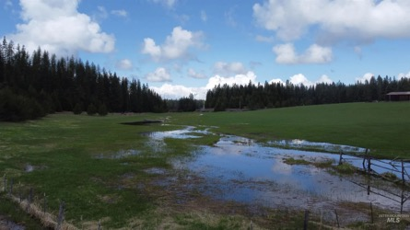
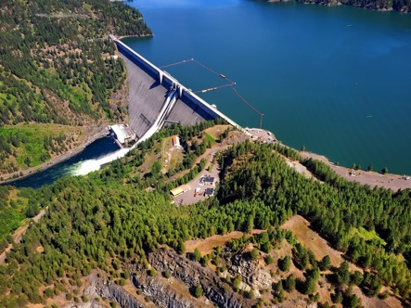
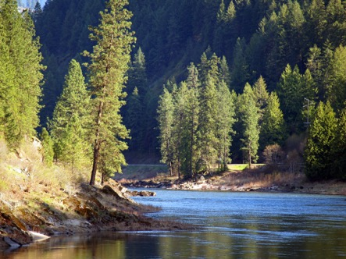
ClearWater: Next Generation Integrated Water Quality Modeling
ClearWater: Corps Library for Environmental Analysis and Restoration of Watersheds
Purpose: Link environmental models with existing water resources models that simulate runoff, rivers, and reservoir hydraulics and hydrology
ClearWater provides environmental simulation capabilities that are designed to leverage existing water resources models.
The ClearWater water quality modules simulate constituent kinetics, heat budget processes, and vegetation growth cycles. Capabilities include:
NSM: Nitrogen, phosphorus, and carbon cycling; dissolved oxygen, algae, etc.
TSM: Temperature (heat budget)
GSM: General Constituents
CSM: Organic and inorganic contaminants
MSM: Mercury
ClearWater contains legacy modules written in Fortran and C++ and next-generation modules written in Python (NSM and TSM)
Engine computes the transport (advection and diffusion) of heat and constituent mass across the watershed
Data visualization capabilities
Framework to integrate multiple models.
Runoff
Reservoirs
Rivers

Slide 11
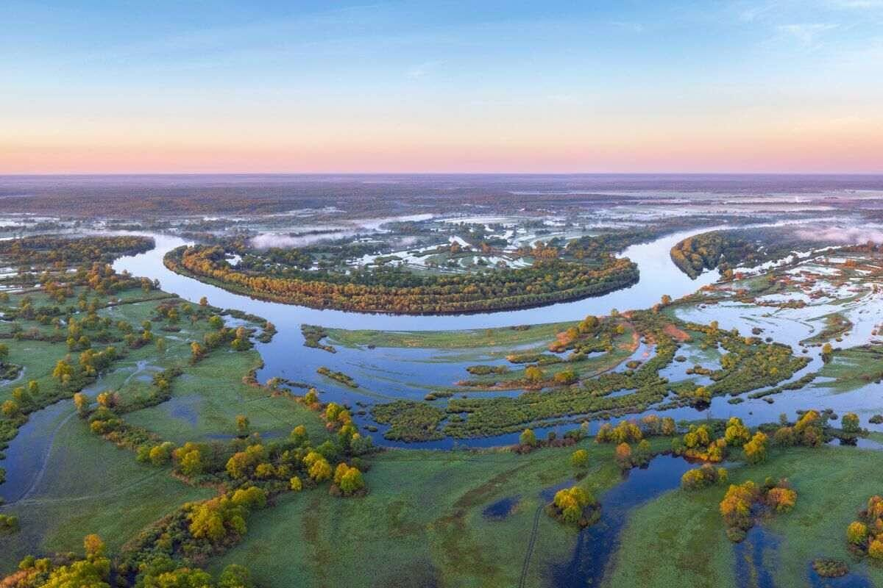
ClearWater-Riverine
ERDC’s new Clearwater-Riverine model simulates temperature and advanced nutrient cycling in branching river systems and floodplains, incorporating hydrodynamic, water quality, and meteorologic inputs from multiple data sources and models.
Water quality kinetics and heat budget are computed for each cell in a computational domain by ERDC's ClearWater modules.
The ClearWater-Riverine framework links the capabilities provided by the ClearWater modules and advection-diffusion engine with the two-dimensional (2D) HEC-RAS model.
ClearWater-Riverine will enable the evaluation of system vulnerabilities and identification of adaptation pathways to improve the resilience of riverine ecosystems to environmental stresses, which include increasing frequency and intensity of extreme precipitation events and decreasing freshwater flows.
HEC-RAS models have been developed for most of the watersheds around the world. By leveraging these existing models, ClearWater-Riverine provides a cost-effective, data-driven tool for impact assessment, planning studies, and the restoration and management of aquatic ecosystems.
Notes:
The ERDC Environmental Laboratory (ERDC-EL) is at the forefront of developing a cutting-edge water quality modeling system called ClearWater-Riverine. This advanced system focuses on simulating temperature dynamics and advanced nutrient cycling in branching river systems and floodplains. It integrates inputs from multiple data sources and models, incorporating hydrodynamic, water quality, and meteorologic information.
The primary goal of ClearWater-Riverine is to assess system vulnerabilities and identify adaptation pathways that enhance the resilience of floodplain ecosystems to environmental stresses. These stresses include the increasing frequency and intensity of extreme precipitation events and decreasing freshwater flows. By accurately simulating water quality kinetics, heat budget, and transport, ClearWater-Riverine enables a comprehensive evaluation of the impacts on water quality and provides insights into potential mitigation and restoration strategies.
The modeling capabilities of ClearWater-Riverine are enhanced through the integration of ERDC's ClearWater modules. These modules provide the necessary functionalities for simulating water quality kinetics, heat budget, and transport processes. They form the foundation for the water quality simulations within the ClearWater-Riverine framework.
Furthermore, ClearWater-Riverine is designed to leverage the widely used two-dimensional (2D) HEC-RAS model. By linking the capabilities of ClearWater modules and the advection-diffusion engine with the 2D HEC-RAS model, ClearWater-Riverine combines the strengths of both systems. This integration allows for a cost-effective and data-driven approach to impact assessment, planning studies, and the restoration and management of aquatic ecosystems.
The availability of HEC-RAS models for numerous watersheds worldwide enhances the applicability and efficiency of ClearWater-Riverine. By utilizing existing HEC-RAS models, ClearWater-Riverine eliminates the need to develop new models from scratch. This approach streamlines the modeling process, reduces costs, and facilitates wider adoption of the system for various water resource management and restoration initiatives.
In summary, the development of ClearWater-Riverine by the ERDC-EL represents a significant advancement in water quality modeling. By simulating temperature dynamics and advanced nutrient cycling, integrating multiple data sources and models, and linking with the 2D HEC-RAS model, ClearWater-Riverine provides a powerful tool for impact assessment, planning, and ecosystem management in river systems and floodplains.

Slide 12
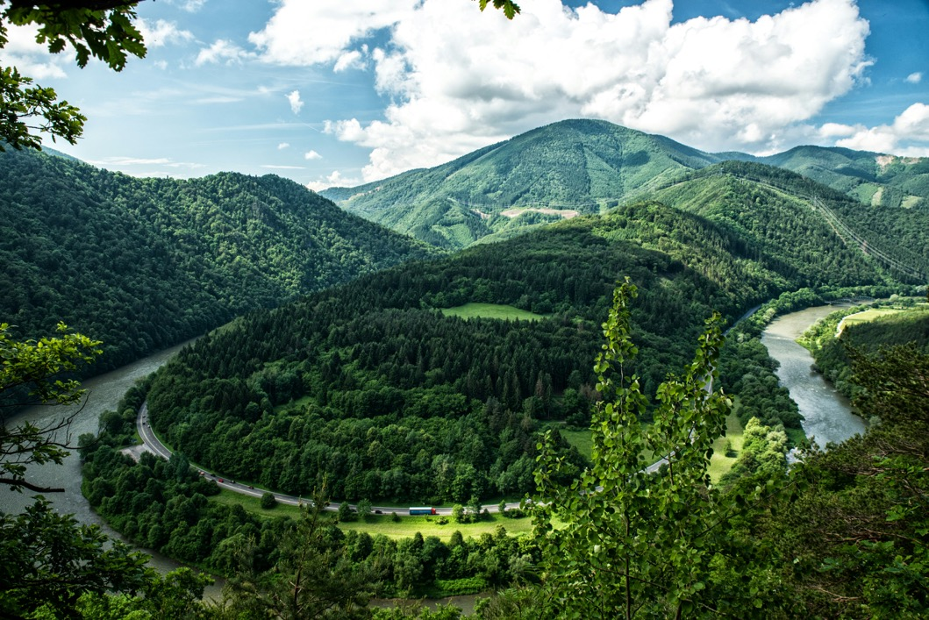

ClearWater-Riverine
Clearwater-Riverine simulates temperature and advanced nutrient cycling in branching river systems and floodplains, incorporating hydrodynamic, water quality, and meteorologic inputs from multiple data sources and models.
Flows: The model grid, volumetric flow, velocities, depths, diffusivity, etc. are provided by existing 2D water resources models.
HEC-RAS (2D)
GSSHA (in progress)
Modules: Water quality kinetics and heat budget simulation capabilities in ClearWater-Riverine are furnished by ERDC's ClearWater modules (e.g., NSM).
Transport: The ClearWater transport engine computes advection-diffusion of heat and mass through the model network.
Framework: The ClearWater framework links all the components together and performs the water quality compute sequence.
Currently design is based on decoupled modeling, i.e., the flows are pre-computed by the hydro models.

Slide 13
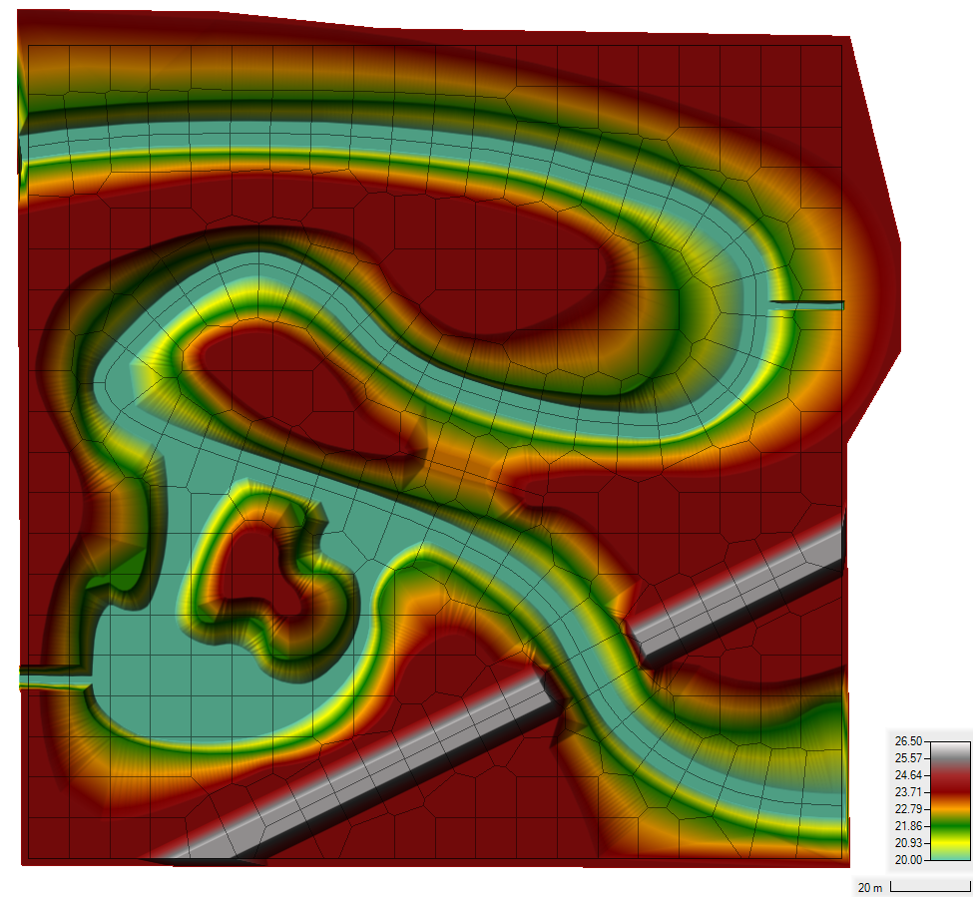
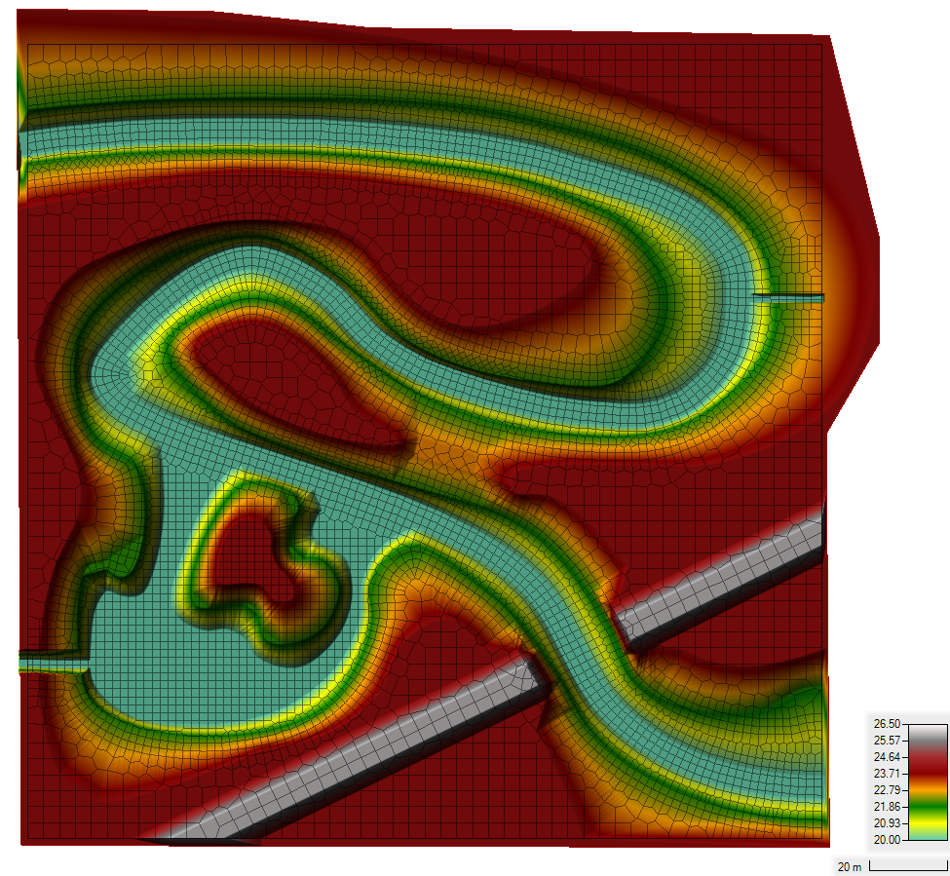
Demo Case Study: Sumwere Creek — Domain & Mesh
Coarse Mesh Fine Mesh
Notes:
Flow field is from HEC RAS-2D output in this case
Domain: 200 meters by 200 meters
Fictitious Topography/Bathymetry
- Bathymetry bottom elevation constant at 20 m
- Floodplain elevation constant at 24 m
- Roadway elevation constant at 26 m
Two Unstructured Meshes Tested
- Coarse Mesh: Base Mesh of 10 m by 10 m
- Fine Mesh: Base Mesh of 4 m by 4 m with a 2 m by 2 m refinement within the creek

Slide 14
Demo Case Study: Sumwere Creek — Hydrodynamic Boundary Conditions
Coarse Mesh Fine Mesh
Upstream: 3 cms
Spring:
1 cms
Powerplant:
0.5 cms
Downstream:
20.75 m
Notes:
HEC-RAS Boundary Conditions
- Upstream Flow for Sumwere Creek constant at 3 cms (1st hour ramping from zero)
- Downstream Stage for Sumwere Creek constant at 20.75 m
- Flow for Cold Spring Creek constant at 1 cms (1st hour ramping from zero)
- Flow for Power Plant Chute constant at 0.5 cms (1st hour ramping from zero)

Slide 15
Demo Case Study: Sumwere Creek — Temperature Boundary Conditions
Coarse Mesh Fine Mesh
Upstream: 15˚C
Spring:
5˚C
Powerplant:
20-25 ˚C
Notes:
Boundary conditions are the same for both the coarse and the fine mesh.
Designed to show longitudinal mixing across the river
Exploration of different extremes (cool water from spring-fed tributary versus warm water from powerplant)

Slide 16
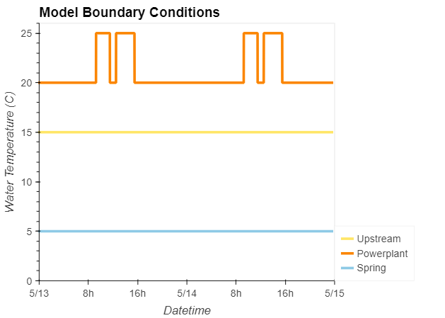
Demo Case Study: Sumwere Creek — Temperature Boundary Timeseries
Coarse Mesh
Upstream: 15˚C
Spring:
5˚C
Powerplant:
20-25 ˚C
Notes:
Timeseries of boundary conditions (stable, except for powerplant discharge)
Powerplant discharge has two peaks during the day (one in the morning, one in the afternoon)

Slide 17
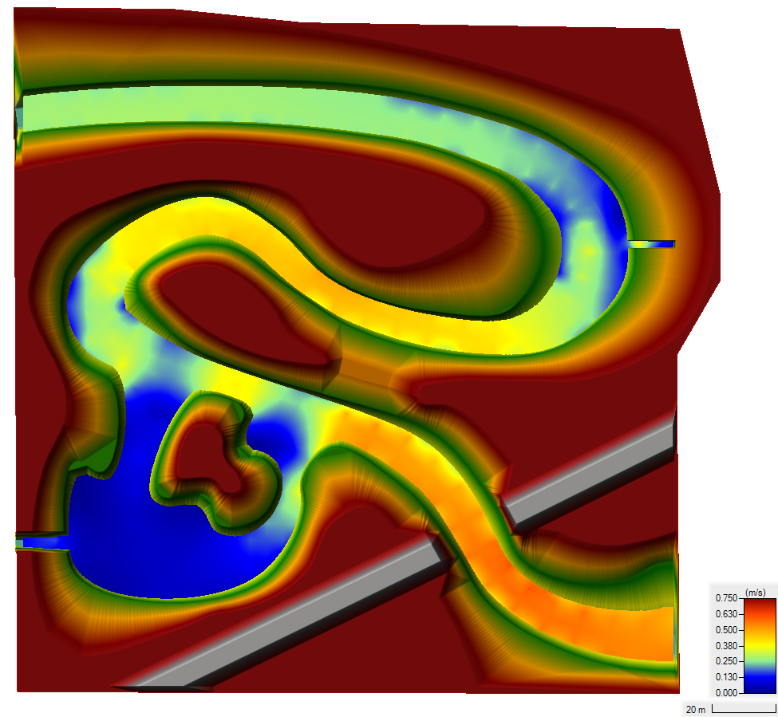
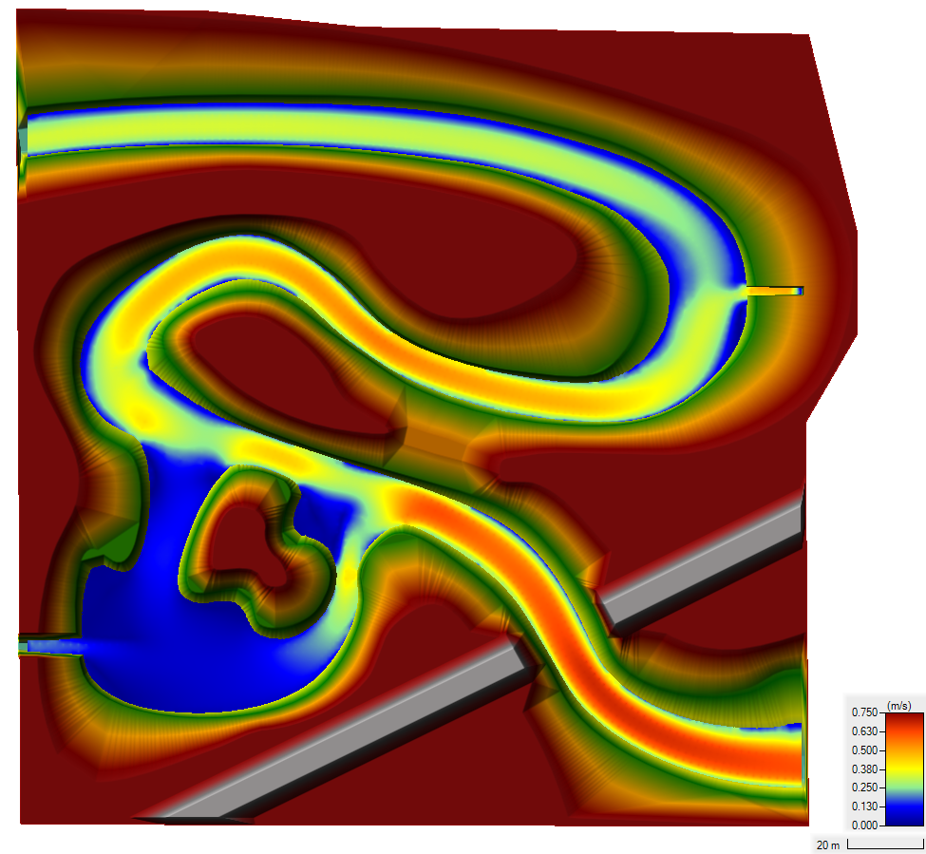
Demo Case Study: Sumwere Creek — Velocity at End of Simulation
Coarse Mesh Fine Mesh
Notes:
Differences in velocities between the meshes are due to varying spatial resolution in each mesh

Slide 18
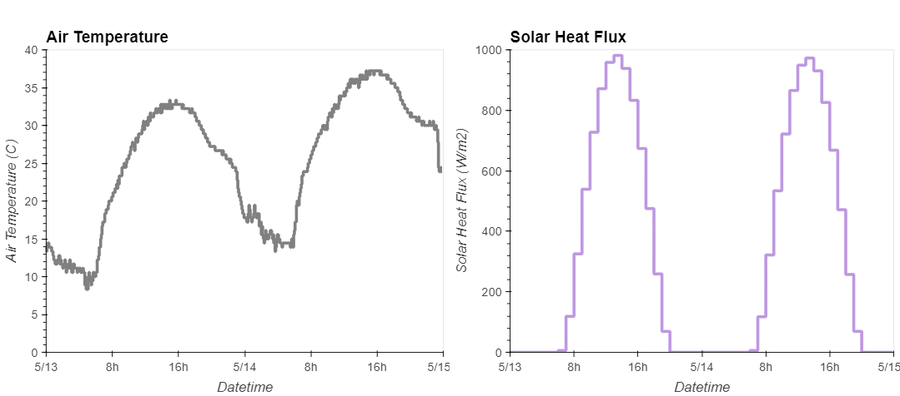
Demo Case Study: Sumwere Creek — Meteorological Timeseries
Notes:
Meteorological timeseries used as inputs to TSM.
Air temperature and solar heat flux both peak during the day and drop at night.
Timeseries from Arizona (extreme cycles to help capture impact of TSM).

Slide 19
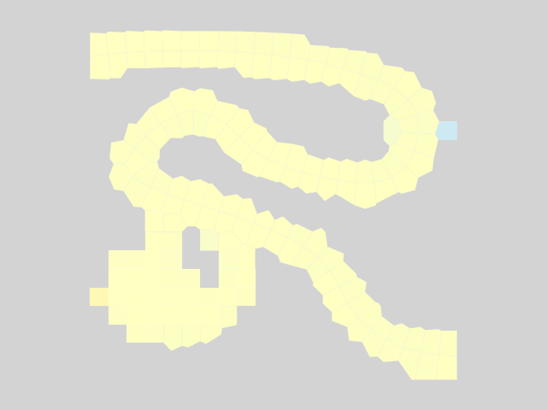
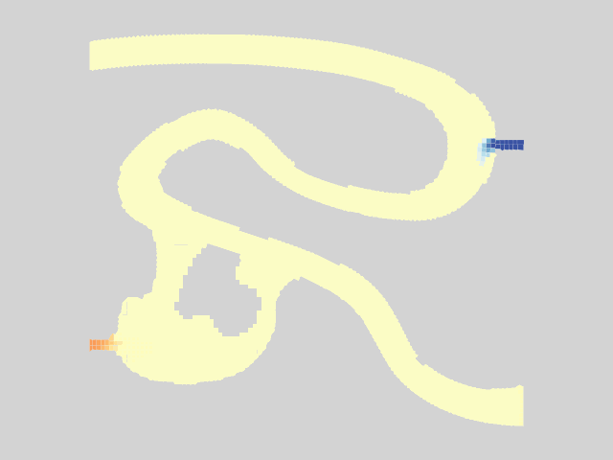
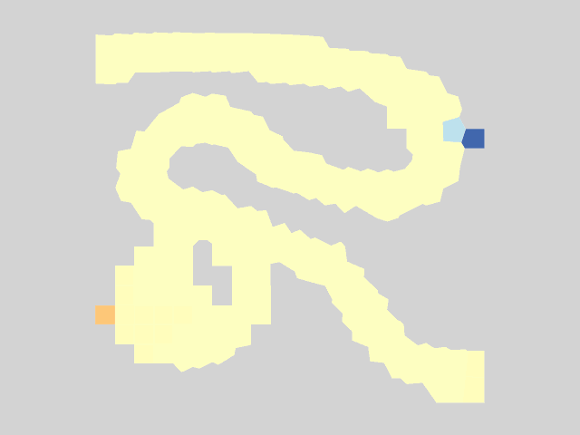
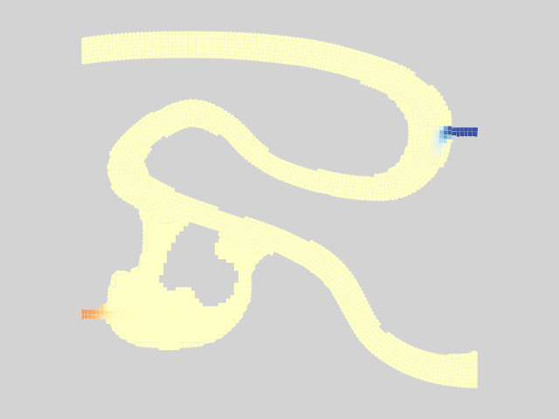
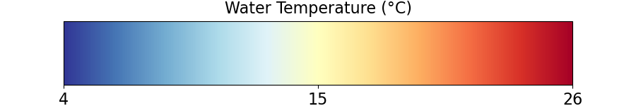
Results – Animation
Coarse Mesh Fine Mesh
Notes:
You can see the mixing.
Ultimately reaches steady state.

Slide 20
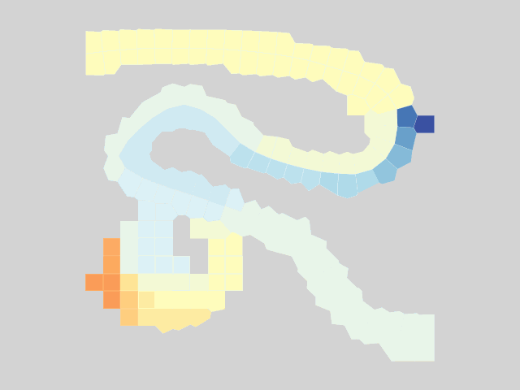
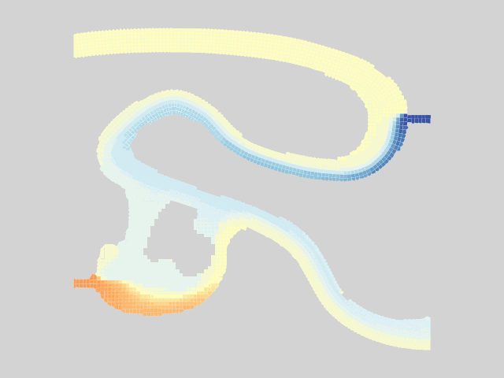

Results – Warm Powerplant Inflows
Coarse Mesh Fine Mesh
Notes:
Pulses from powerplant.
Can see a lot more transverse mixing from the powerplant and spring in the fine mesh compared to the coarse mesh.
Can see more detail on the plume of warm water.
This all shows transport very clearly, but what about our energy budget model / TSM?

Slide 21
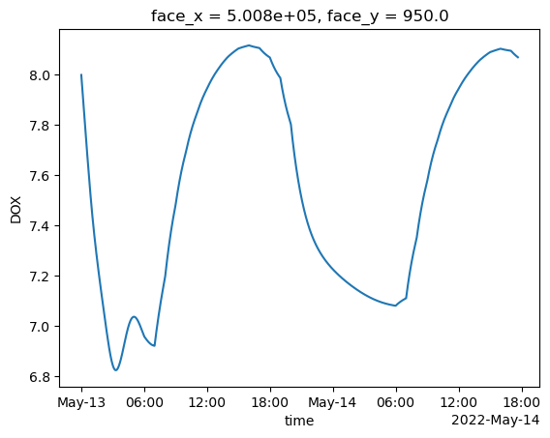
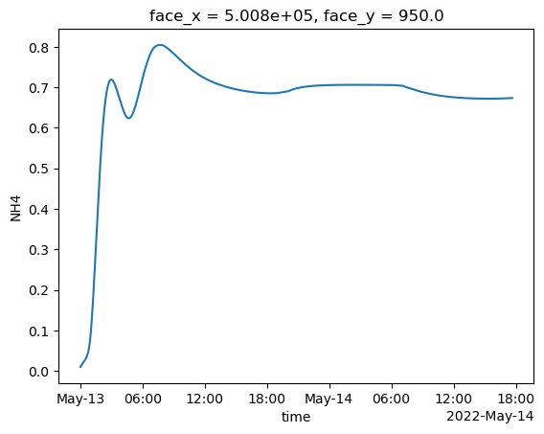
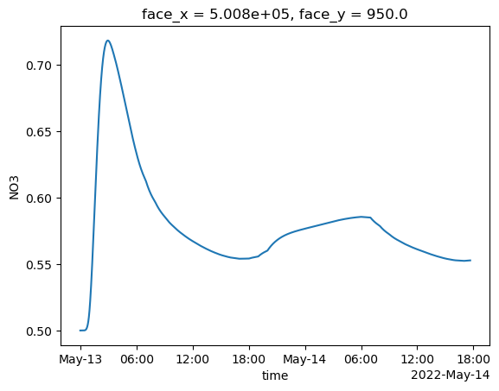
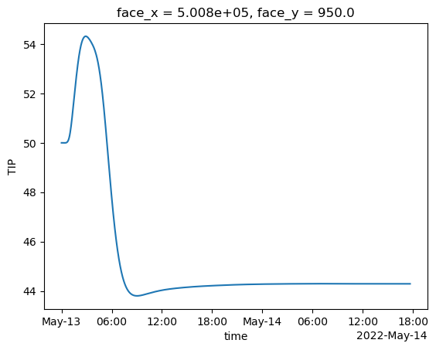
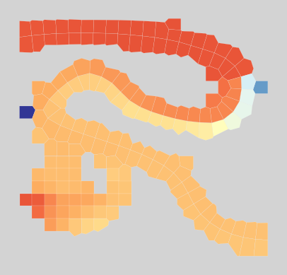
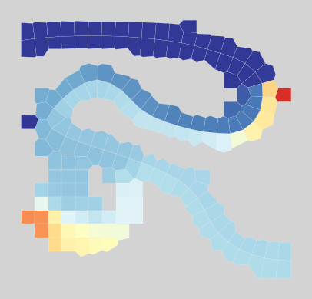
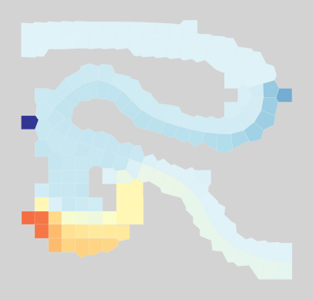
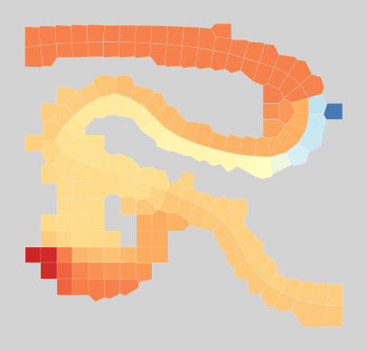
Nutrient Modeling Capabilities
Dissolved Oxygen
Ammonia (NH₄)
Nitrate (NO₃)
Total Inorganic Phosphorus (TIP)
Notes:
Pulses from powerplant.
Can see a lot more transverse mixing from the powerplant and spring in the fine mesh compared to the coarse mesh.
Can see more detail on the plume of warm water.
This all shows transport very clearly, but what about our energy budget model / TSM?

Slide 22
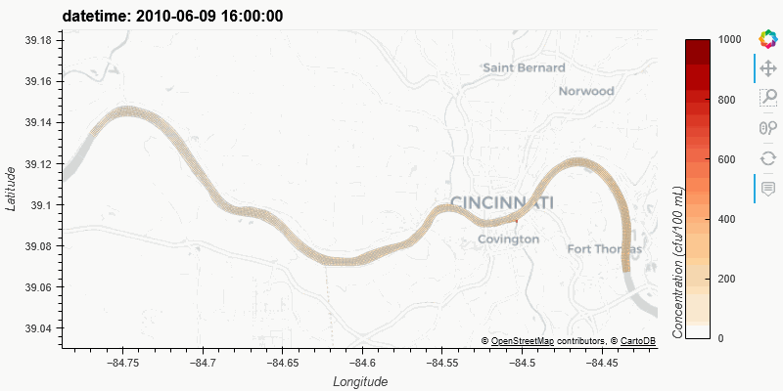
ClearWater-Riverine Example: E. Coli Transport in the Ohio River

Slide 23
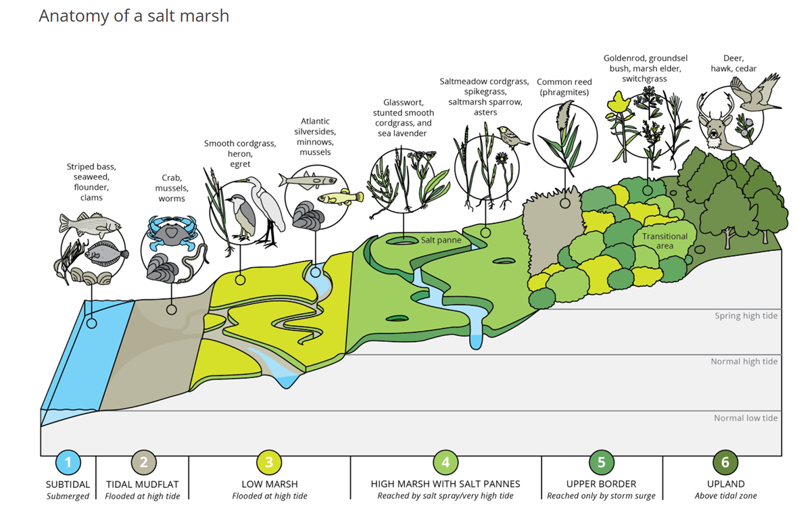
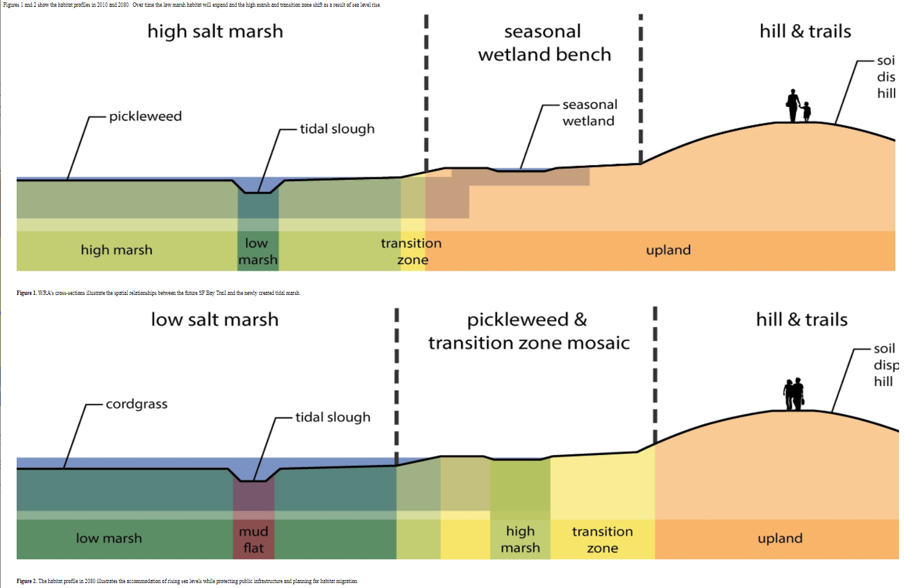
Hydro-Ecological Salt Marsh Model (Task 11)
Long-Term Goal: Inform design guidelines for constructed salt marshes NNBF for specific performance levels of wave attenuation, erosion reduction, and habitat creation.
Objective: Develop a “unit” salt marsh model that can demonstrate how to:
Design salt marshes for specific performance objective(s) that are robust to range of potential future sea level and sediment input conditions
Quantify performance using measurable performance metric(s)
Identify those marsh parameters (e.g., platform depth, vegetation species dominance, etc.) to which performance is most sensitive to.
Lead to the development of generalized salt marsh model design guidelines

Slide 24
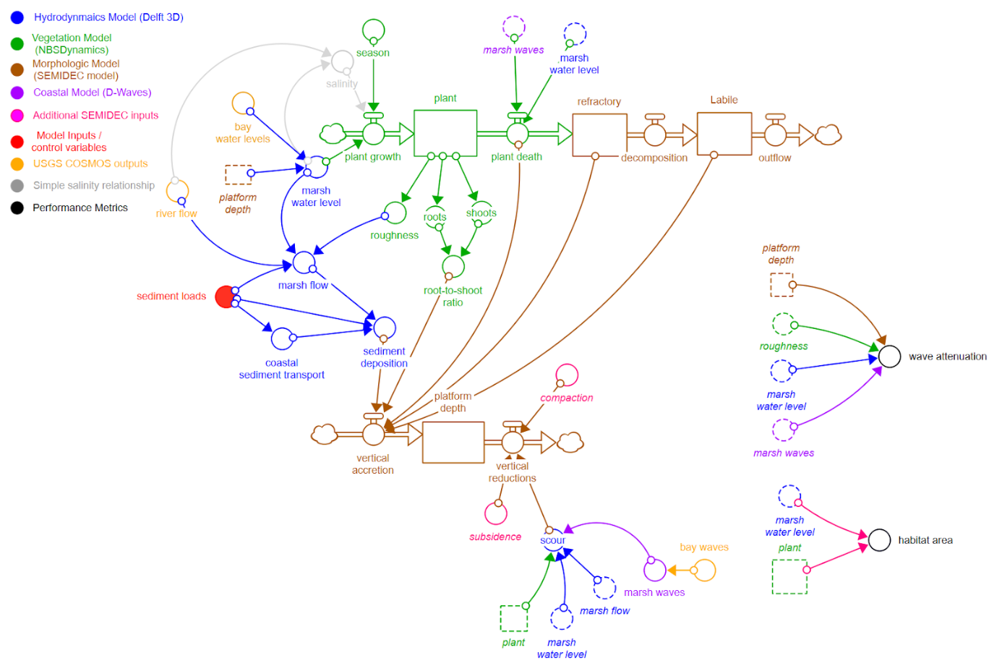
FY24 Salt Marsh Model: Design
Flow diagram of our complete salt marsh model
Performance metrics we are computing

Slide 25


FY24 Salt Marsh Model Case Study
Case Study Site: Dotson Family Marsh, San Pablo Bay
The Dotson Family Marsh is a 238-acre (96 ha) regional park on San Pablo Bay in the East San Francisco Bay Area city of Richmond, California.
In 2009 the East Bay Regional Parks District acquired the marsh site, adding it to Point Pinole Regional Shoreline.
A habitat restoration plan for 60 acres of wetlands and 90 acres of California coastal prairie was subsequently approved.

Slide 26


FY24 Salt Marsh Model Case Study
Vegetation coverage, Dotson Family Marsh
The colors represent different species.
The site started out with no vegetation. This snapshot is a few years after installation.
Elevations, Dotson Family Marsh

Slide 27

FY24 Salt Marsh Model Case Study
Map showing the larger model (Nederhoff et al. 2021) that we nested our salt marsh model into.
This larger model will be used to generate water level and wave boundary conditions for our smaller salt marsh model.

Slide 28


FY24 Hydro-Ecological Model Development
Collaborating with Deltares and Drs. Matt Smith and Marriah Abellera (IWR) to explore the modeling of salt marshes with the goal of informing design for specific performance objectives.
Completed prototype of the dynamic salt marsh model. It dynamically couples
Hydrodynamics (Delft3D)
Waves (Waves-D)
Vegetation (NBSDynamics)
Morphology (SEMIDEC)
Working meeting with Deltares (in Delft) Oct 24-27, 2023:
Finalizing and linking the components of the salt marsh model (hydrodynamics + waves + sediment, morphology, and vegetation growth / death)
Weekly meetings with Deltares Delft 3D experts to continue to make progress on the model

Slide 29





Technical Exchange and Water Quality Modeling Training at Deltares (Delft, Netherlands) 29 January – 9 February, 2024
USACE SMEs from the IWR and ERDC offices traveled to Delft, Netherlands to participate in multiple working meetings and technical exchange with Deltares (water resources research institute) and Rijkswaterstaat (Netherlands Ministry of Infrastructure & Water Management) SMEs. The USACE team participated in working meetings and a 2-day Delft3D water quality modeling training from Deltares SMEs in support of salt marsh modeling work under the ACTIONS (ERDC) and SAGE (IWR) programs. Other meetings topics included topics of long-term collaboration between the USACE and Rijkswaterstaat /Deltares including Nature-Based Solutions (NBSs) as well as CRIDA (Climate Risk Informed Decision Analysis).
NATURE-BASED SOLUTIONS (NBS) & SALT MARSH MODELING:
On 29 January 2024, Marriah Abellera (IWR) and Guillermo Mendoza (IWR) led a workshop on the development of an international manual for resilient planning and justification of NBS’s for flood and drought management.
Participants included SMEs from Deltares, Rijkswaterstaat, TUDelft, Wageningen University, ARCADIS, Ecoshape, the World Bank, and USACE.
From 30 Jan through 4 Feb, the USACE team including Marriah Abellera (IWR), Matt Smith (IWR), Jennifer Olszewski (ERDC), and John Kucharski (ERDC) met with Deltares SMEs to advance work on a salt marsh model being developed by USACE under the ACTIONS and SAGE programs.
The USACE team participated in a Delft 3D Water Quality Modeling training led by Deltares SMEs on Jan 31 and Feb 2. Methods learned in this training will go to inform the USACE salt marsh modeling effort.
TRIP OUTCOMES / NEXT STEPS:
The USACE team will develop initial draft of the International Manual for Resilient Planning with NBS’s in collaboration with Netherlands and University counterparts.
The USACE team will finalize the salt marsh model and perform initial sensitivity analyses to relate design parameters (e.g., starting marsh elevation) and performance (e.g., wave attenuation).
The USACE and Deltares teams will continue collaboration around salt marsh research to inform constructed salt marsh design for specific objectives.
The USACE team will continue collaboration with Deltares and UNESCO to further develop the CRIDA methodology and training materials.
Screen shots of the USACE salt marsh model, which, when complete will couple hydrodynamic, waves, morphology, and vegetation growth / death processes.
CLIMATE RISK INFORMED DECISION ANALYSIS (CRIDA) :
John Kucharski (ERDC) participated in a CRIDA planning workshop that took place 6-7 Feb that included participants from Deltares and UNESCO.
The purpose of this meeting was to evaluate the current state of the practice of CRIDA and to define next steps for the collaborative development of a CRIDA 2.0 and formal training materials.
Mr. Kucharski led discussions related to the economic analysis as well as a CRIDA university course he, Dr. Olszewski (ERDC), and Dr. Mendoza (IWR) are developing in the Dominican Republic.
Deltares SME Jasper Dijkstra lead a tour of the “Zandmotor”(translating to “sand engine”) beach nourishment project for the USACE team. The Zandmotor provides a real-world example of a successful NBS designed for coastal preservation and flood protection.
USACE and Deltares SMEs discuss details of USACE salt marsh model.

Slide 30
FY25 Milestones and Products
Q2/FY24 (Product): ClearWater-Riverine model optimized to perform high speed simulations of temperature and nutrient flow for river systems in military installations
Q1/FY24 (Milestone): Run all scenarios for selected time series and marsh site(s) through (1) just hydrodynamics + waves model, (2) hydrodynamics + waves + NETHERLANDS, and (3) hydrodynamics + waves + NETHERLANDS + NBSDynamics.
Q2/FY25 (Deliverable): Submit Paper 1 to journal (Value of Coupling Models + Initial Sensitivity Analysis). Title: “Modeling evolution and dynamic equilibrium of constructed salt marshes using a coupled morpho-dynamic and vegetation model to evaluate wave attenuation performance”
Q2/FY25 (Deliverable): Document detailing the specifications of the emulator including models it will emulate, marsh site(s) to be used, initial list of necessary inputs and outputs, how performance will be evaluated and optimized, software / code format and location.
Q3/FY25 (Milestone): Finalize list of additional scenario runs necessary to train the emulator.
Q4/FY25 (Deliverable): All necessary inputs and outputs generated to train emulator.
Q4/FY25 (Deliverable): Initial emulator completed and validated with training inputs/outputs
Q4/FY25 (Deliverable): Submit Paper 2 (salt marsh emulator) to journal
Q4/FY25 (Deliverable): Submit Paper 3 (linking upstream nutrient flows with salt marshes)

Slide 31
FY25 Publications
Paper 1 (Value of Coupling Models + Initial Sensitivity Analysis)
Hypothesis: Coupled hydrodynamic-morphological-vegetation simulations can effectively model the morphologic and vegetative evolution of a marsh better than non-coupled simulations.
Goal 1: Given a single timeseries of inputs, demonstrate the incremental benefit of the NBSDynamics, NETHERLAND modules on model calibration and validation of marsh morphology and vegetation colonization.
Goal 2: Identify a set of uncertain parameters that correspond with stressors, and/or design parameters (e.g., mean water level, storm intensity/frequency, initial bed level). Perform a Sobel Variance Analysis to measure the portion of wave attenuation and habitat performance attributed to each stressors and/or design parameter and their interactions.
Paper 2 (Emulator)
Hypothesis: Simulation models with a hydrodynamic emulator can be used to identify the range of conditions that lead to stable and unstable dynamic equilibria, and successful or unsuccessful levels of performance.
Goal: To develop and validate an emulator that produces hydrodynamic inputs needed to run vegetation and morphologic (NBSDynamics / NETHELAND) models.
Paper 3 (Riverine Nutrient Model)
Hypothesis: Nutrient flow models will help anticipate the impact of changing ecosystem services on critical infrastructure.
Goal: To develop a riverine nutrient model that links freshwater nutrient flows from the upland watershed to the salt marsh ecosystem.

Slide 32

Questions?

